Slide 1
Chapter 2
THE DATABASE ENVIRONMENT
Introduction to Databases:
      ANSI-SPARC Architecture
      Data independence
      Data models
      Relational database concepts
      Introduction to DDL & DML

Slide 2
One of the aim of a database system is to provide users with an abstract view of data, hiding certain details of how data is stored and manipulated.
Furthermore , A database is a shared resource , therefore different users might require different views of the same database.
therefore to satisfy these needs , the architecture of most commercial DBMS is based on the ANSI-SPARC ARCHITECURE.
ANSI-SPARC: American National Standards Institute – Standards Planning and Requirements Committee.
Introduction to Database Languages
1.<number>

Slide 3
The 3-level ANSI-SPARC Architecture
The objective of Three-level architecture is to:
Separate each users view of the database from the way the database is physically represented.
Was developed to provide users with their own view of data.
Hides certain details of how data is stored and manipulated.
Helps achieve data independence.
ANSI-SPARC Architecture

Slide 4
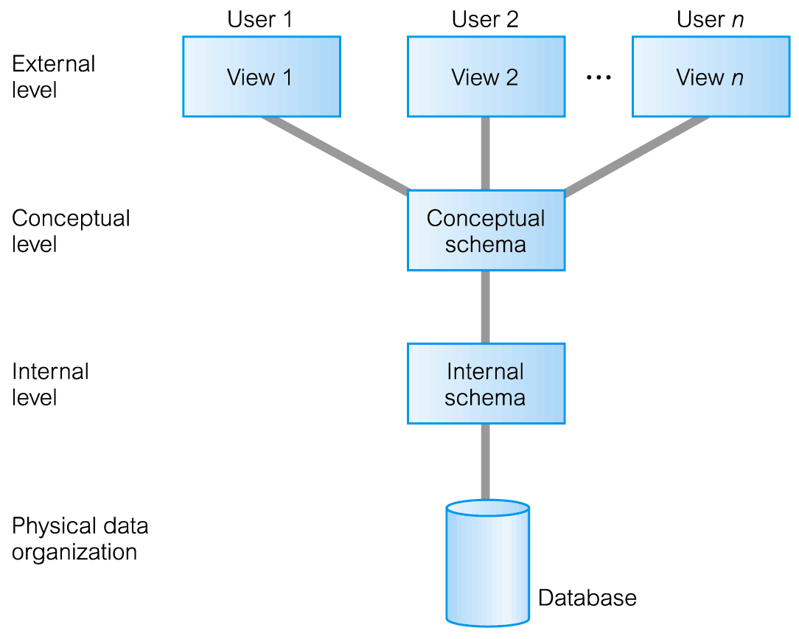
ANSI-SPARC 3-Level Architecture
ANSI-SPARC Architecture

Slide 5
THE ANSI –SPARC ARCHITECURE
The ANSI-SPARC Architecture is the most common standard on which database systems were developed. Databases follow the generalized architecture. It is made up of three levels.
.
1.<number>

Slide 6
External level:
  -Describes that part of DB that is relevant to a particular user and doesn’t disclose the other parts.
Other entities, attributes, or relationships that are not of interest.
may be represented in the database, but the user will be unaware of them.
In addition, different views may have different representations of the same data. Views may even include data combined or derived from
several entities.
Introduction to Database Languages
1.<number>

Slide 7
Conceptual Level
The conceptual level represents :
  This describes the logical structure of the entire database. That is the relations/entities and the relationship among the data.
  Or
  Community view of the database
Constraints on the data. ie rules enforced on data.
security and integrity information.
NB Data from any view is derived from the conceptual level.
Introduction to Database Languages
1.<number>

Slide 8
The Internal Level
It describes how the data is actually stored in the database and on the computer hardware. In other wards the physical representation of the database on the computer.
File management techniques for storing and retrieving data records)
data compression and data encryption techniques.
The way the DBMS and the operating system perceive the data .
  Data structure is a particular way of storing and organizing data in a computer so that it can be used efficiently.
Introduction to Database Languages
1.<number>

Slide 9
The 3-level ANSI-SPARC Architecture
The following are reasons why this separation is desirable;
  All users should be able to access same data. But have a different customized view of the data .A user’s view is immune to changes made in other views.
  DBA should be able to change conceptual structure of database without affecting other user’s views.
ANSI-SPARC Architecture

Slide 10
Cont’d
Users do not need to know physical database storage details.
DBA should be able to change data at the conceptual level without affecting users at the higher level.

Slide 11
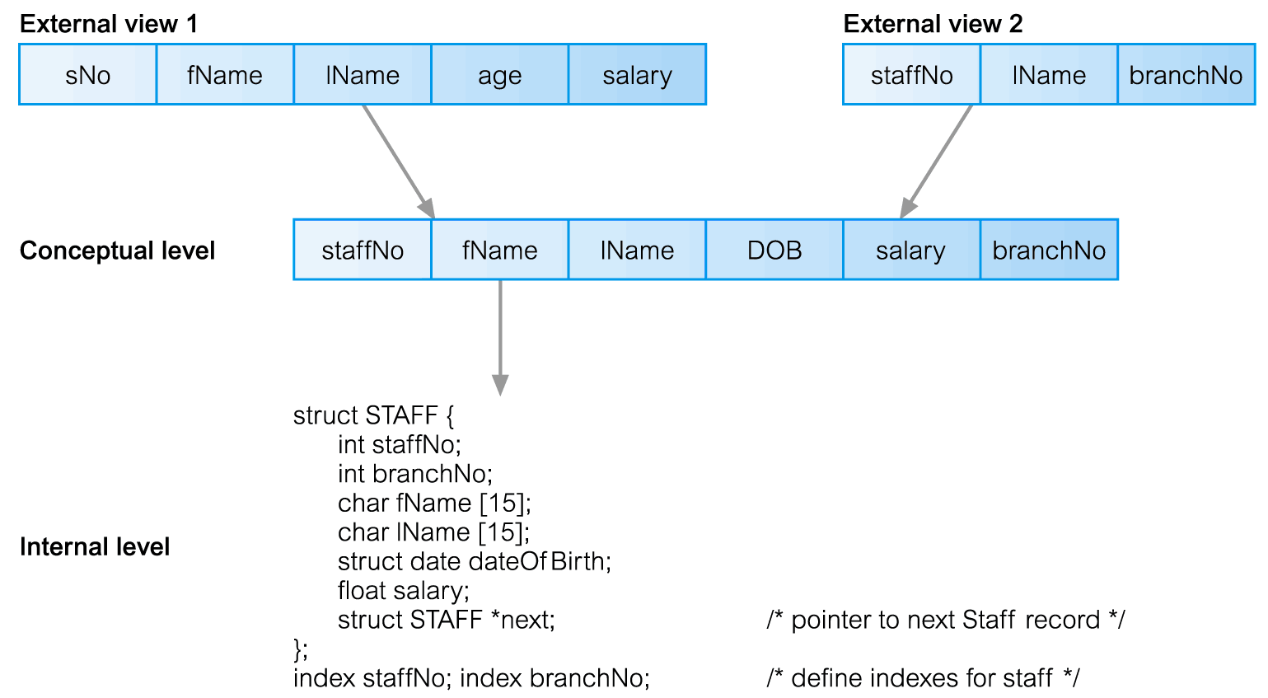
Differences between Three Levels of ANSI-SPARC Architecture
ANSI-SPARC Architecture

Slide 12
Data Independence
Data independence in DBMS ensures that the data cannot be redefined or reorganized by any of the programs that make use of the data.
Refers to the immunity/resistance of user applications to make changes in the definition and organization of data.
Each higher level of the data architecture is immune to changes of the next level of the architecture.
Introduction to Database Languages
1.<number>

Slide 13
Data Independence 2 types
Logical Data Independence
  The ability to change the logical schema without changing the external schema .
  Refers to immunity of external schemas to changes in conceptual schema.
Changes to the conceptual schema, such as the addition or removal of new entities,
attributes, or relationships, should be possible without having to change existing external.
  Users for whom the changes have been made, need to be aware of them- other users should not.
ANSI-SPARC Architecture

Slide 14
Data Independence
Physical Data Independence
  Refers to immunity of conceptual schema to changes in the internal schema.
  Internal schema changes (e.g. using different file organizations, using different storage devices).
  Users only notice the change in the performance ( because deterioration in the performance is the major cause for internal schema changes)
ANSI-SPARC Architecture

Slide 15
Data Model
A model is a representation of ‘real world’ objects and events and their associations.
A database model is an organizational principle used in organizing data by the database management systems.
Models provide a picture of representation of reality.
Introduction to Database Languages
1.<number>

Slide 16
DATABASE MODELS: Data Model
Provide basic notations and concepts that enable database designers and end-users to unambiguously and accurately communicate their understanding of the organisational data.
If not done well, serious problems may be caused later in the development process.
  Purpose: To represent data in an understandable way.
Data Model comprises:
  A structural part
  A manipulative part
  Possibly a set of integrity rules

Slide 17
Data Model
Data Model comprises:
  A structural part consists of a set of rules according to which databases can be constructed.
  A manipulative part defining the types of operations that are allowed on the data. Operations that are used for updating , retrieving and changing the database structure.
  Possibly a set of integrity rules which ensure that data is accurate.
Purpose of Data Model.
  To represent the data in an understandable way.
Introduction to Database Languages
1.<number>

Slide 18
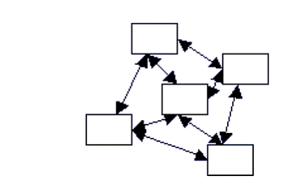
Types of Data Models.
Network Model: Represents data as nodes and relationships are implied by linking up the nodes by edges.
Introduction to Database Languages
1.<number>

Slide 19
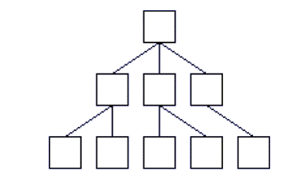
Hierarchical Model: A tree-graph representation is used (records/segments as nodes and sets as edges.)
    A node is allowed to have only one parent
Represents data and nodes in a hierarchical manner.
Introduction to Database Languages
1.<number>

Slide 20


Hierarchical Database
Customers
Customer
Order
Items Ordered
Orders
To retrieve data, you must start at the top (customer). When you retrieve a customer, you retrieve all nested data.
Items
Item Description Quantity
998 Dog Food 12
764 Cat Food 11

Slide 21
Data Models
Relational Model: Uses relations/tables to organize data. A row /tuple represents an instance of data and relationships are represented by foreign keys.
    Data and relationships are represented as tables, each having uniquely identified columns
The Object Oriented Model: Uses the object oriented paradigm of encapsulation, inheritance . Aclass represents data and an object represents the instance.
Customer(CustomerID, Name, …
Order(OrderID, CustomerID, OrderDate, …
ItemsOrdered(OrderID, ItemID, Quantity, …
Introduction to Database Languages
1.<number>

Slide 22
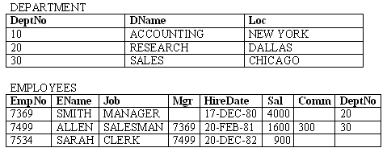
Example of a Relational DB
A company needs to store information on departments and employees.
Each table contains data that describes exactly one entity - a thing of significance about which information needs to be known.
Relational Database Concepts
1.<number>

Slide 23
Relational Database Concepts Cont’d
Degree – The number of attributes in a relation is degree of that relation.
Cardinality – number of tuples for a given relation.
Relation schema- Refers to information describing
a table. This includes a set of column names, the data types associated with each column, and the name associated with the entire table
Null – a value that is unknown or not applicable in a given cell. representation of "missing information and inapplicable information".
  Constraints: Enforce rules at table level. Eg Not Null, Primary key ,Foreign Key, Check
Relational Database Concepts
1.<number>

Slide 24
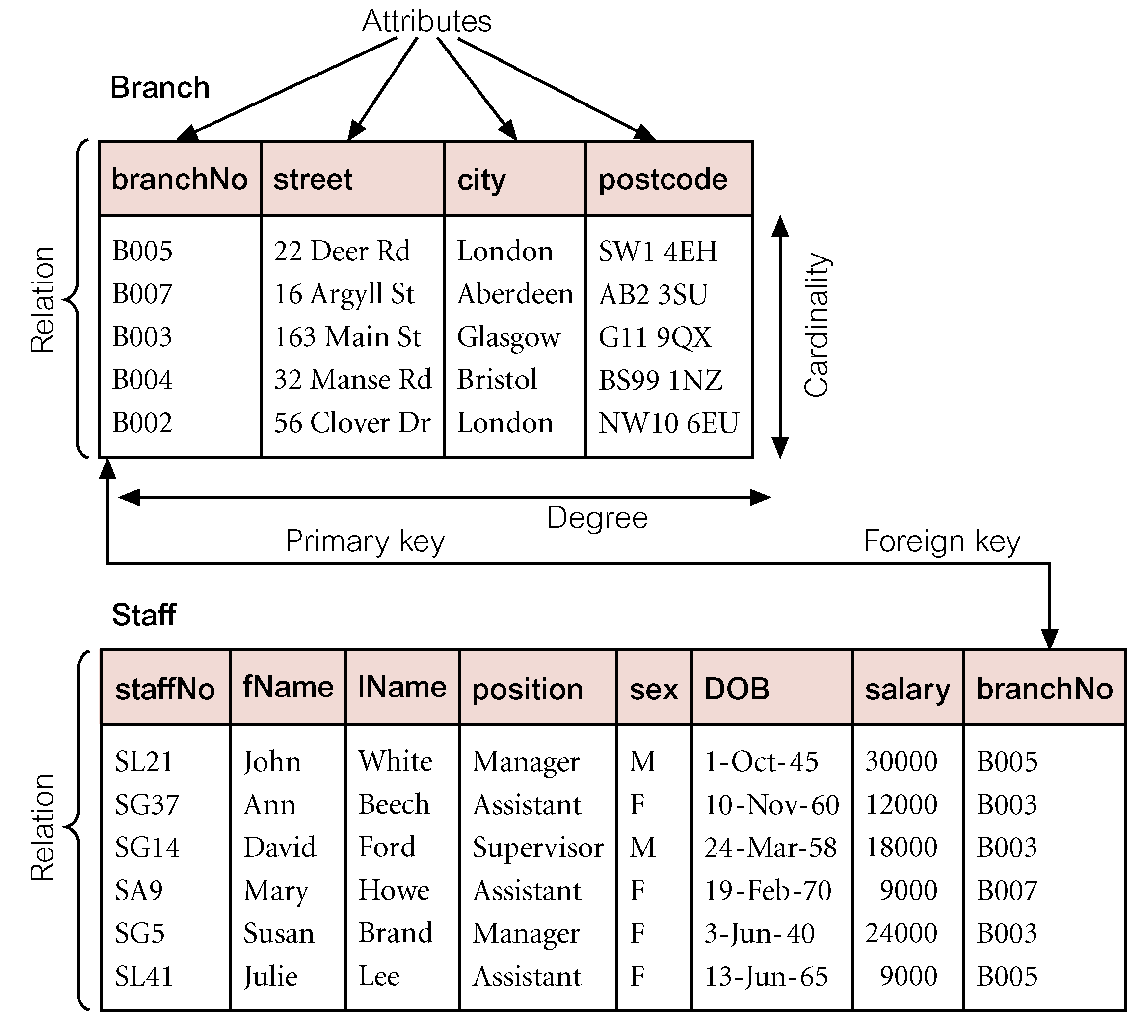
Instances of Branch and Staff (part) Relations
Relational Database Concepts
1.<number>

Slide 25
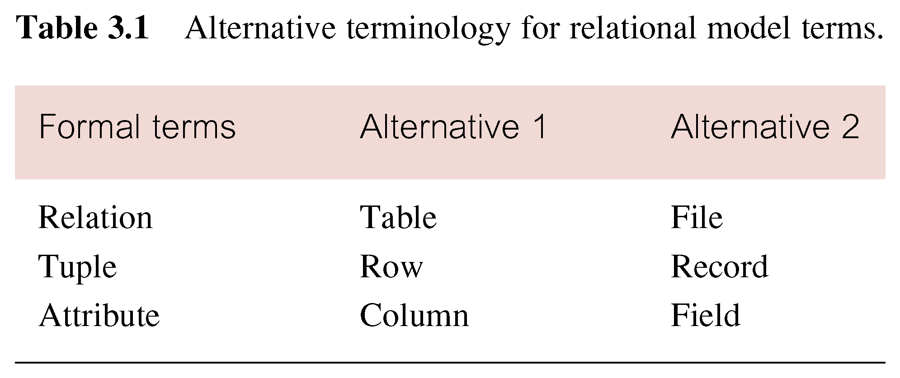
Alternative Terminology for Relational Model
Relational Database Concepts
1.<number>

Slide 26
Relational Database Concepts Cont’d
Relational database – A database whose structure is made up of numerous separate but linked tables.
Enterprise Constraints
  Additional rules specified by users or database administrators.
  Examples of enterprise constraints. able Check Constraint
  Primary Key Constraint, Unique Key Constraint.
Representation of a relational database schema for a company that stores information on departments and employees.
  DEPARTMENT (DeptNo, DName, Loc)
  EMPLOYEES (EmpNo, EName, Job, Mgr, HireDate, Sal, Comm, DeptNo)
Relational Database Concepts
1.<number>

Slide 27
Relational Integrity Cont’d
Entity Integrity
  In a base relation, no attribute of a primary key can be null. (Please note that this is a correct statement: because a primary key may be formed of more than one attribute.)
Referential Integrity
  If foreign key exists in a relation, either foreign key value must match a candidate key value of some tuple in its home relation or foreign key value must be wholly null.
Relational Database Concepts
1.<number>

Slide 28
Relational Database Concepts Cont’d
Primary key – An attribute that is selected to uniquely identifies each record within a relation.
A primary key value must be unique and cannot be null.
Foreign key – An attribute within one relation that matches another attribute of another or same relation.
A foreign key value must match the primary/unique key value of some tuple in its parent relation or the foreign key value must be wholly null.
Relational Database Concepts
1.<number>

Slide 29
Database Languages
Database Languages are known as data Sublanguages. And consist of two parts : A DDL and DML
DBMSs have a facility for embedding the sublanguage in a high-level programming language e.g. C, C++, Java Or VB. The high-level language is then known as a host Language.
Introduction Database Languages
1.2.<number>

Slide 30
Database languages Cont’d
A data sublanguage consists of two parts:
  Data definition Language (DDL)
  This is a language that allows the DBA or user to describe and name the entities, attributes and relationships required for the application, together with any associated integrity and security constraints.
  Used to specify the database schema.
Introduction Database Languages
1.2.<number>

Slide 31
Data Definition Language (DDL)
DDL is not only used to specify new database schemas but also to modify exiting ones. A database schema is a logical grouping of objects that belong to a user.
All created objects / structures (such as tables, views) are stored in a database schema.
Data Definition Languages
1.2.<number>

Slide 32
DDL cont’d
Relation DB schema objects are created and maintained by using SQL DDL statements (such as CREATE, ALTER, DROP).
The result of compiling DDL statements is a set of tables stored in special files collectively called the system catalog.
The system catalog may also be referred to as a data dictionary.
Data Definition Languages
1.2.<number>

Slide 33
DDL Cont’d
The data dictionary integrates the meta-data; definitive information about the structure is recorded in a data dictionary.
  For example: definitions about the records, data items and other objects of interest to users or required by the DBMS.
Example of DDL SQL statement:
  CREATE, ALTER, DROP, RENAME, TRUNCATE
Data Definition Languages
1.2.<number>

Slide 34
Data Manipulation Language (DML)
This is a language that provides a set of operations to support the basic data manipulation operations on the data held in the database.
Some of the operations include:
  Insertion of new data into the database
  Modification of data stored in the database
  Retrieval of data contained in the database (Query language).
  Deletion of data from the database.
Data Manupulation lanaguages
1.2.<number>

Slide 35
DML Cont’d
Non-Procedural DML
allows user to state what data is needed rather than how it is to be retrieved.
The end-users use a high-level query language to specify their requests to DBMS to retrieve data. Usually a single statement is given to the DBMS to retrieve or update multiple records.
Data Manupulation lanaguages
1.2.<number>

Slide 36
Procedural DML
  This a language that allows the user to tell the system what data is needed and exactly how to retrieve the data; allows user to tell system exactly how to manipulate data.
  This type of DML typically retrieves individual records from the database and processes each separately. In this language, the looping, branching etc. statements are used to retrieve and process each record from a set of records.
Introduction to Database Languages
1.<number>

Slide 37
DML Cont’d
Examples of DML SQL statements;
  INSERT
  UPDATE
  DELETE
  MERGE
  A LTER
Data Manupulation lanaguages
1.2.<number>

Slide 38
Multi-User DBMS Architecures
Teleprocessing
File Server
Client -Server
Introduction to Database Languages
1.<number>

Slide 39
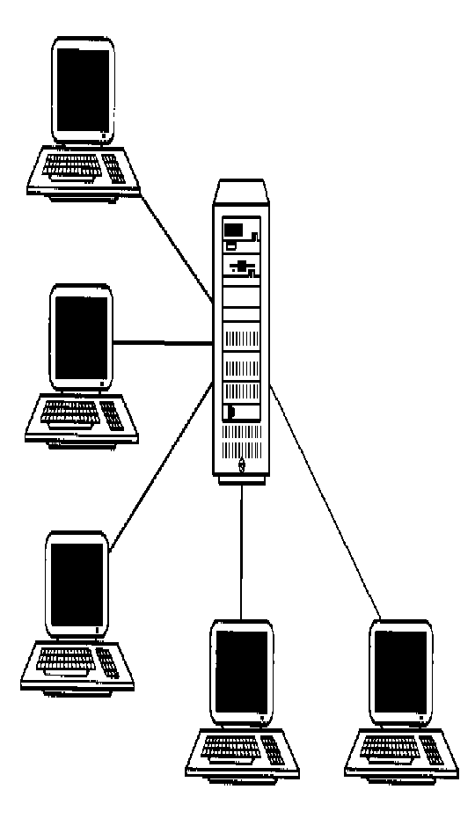
Teleprocessing
Traditional Architecture
Single mainframe with a number of terminals attached .
One computer with a
single CPU and a number of terminals. All processing is done within the boundaries of physical computer.
.
Introduction to Database Languages
1.<number>

Slide 40
File-Server
File Server is connected to several workstations across the network.
Database resides on file-server.
However the DBMS and applications run on each workstation.
The file-server acts simply as a shared hard disk drive.
Disadvantage,
copy of DBMS on each work station.

Slide 41
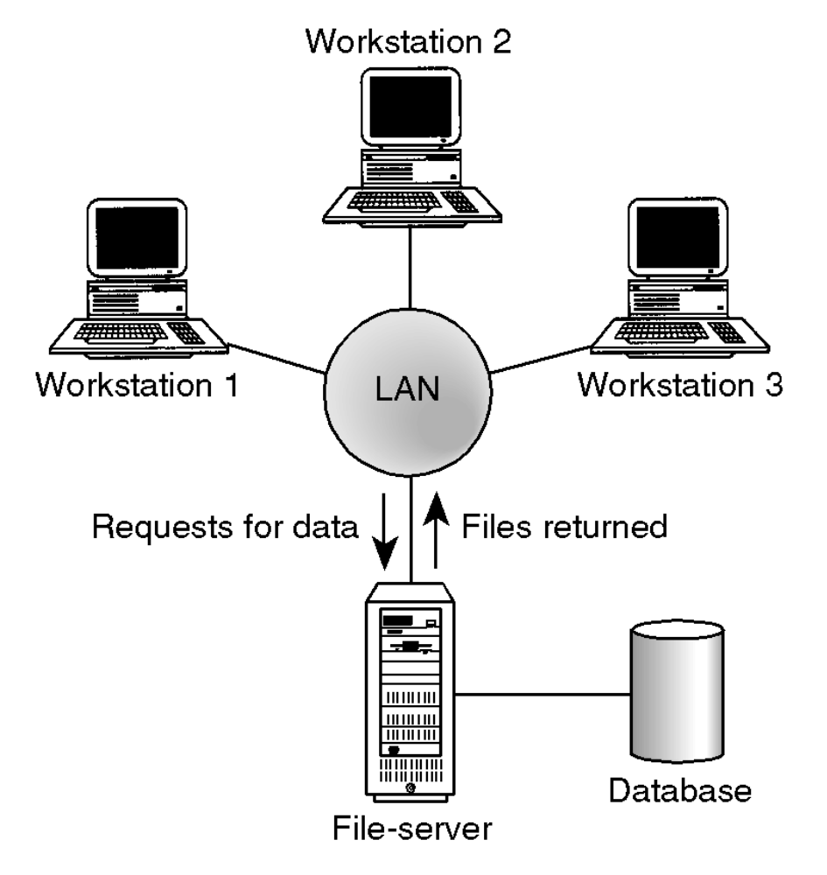
File Server Architecture
Introduction to Database Languages
1.<number>

Slide 42
Client-server
Server holds the database and the DBMS.
Clients manages users interface and runs applications.
The client is primarily responsible for the presentation of data to the user, and the server is primarily responsible for supplying data services to the client
Advantages include:
Wider access to existing databases
Increased performance.
Possible reduction in hardware costs.
Introduction to Database Languages
1.<number>

Slide 43
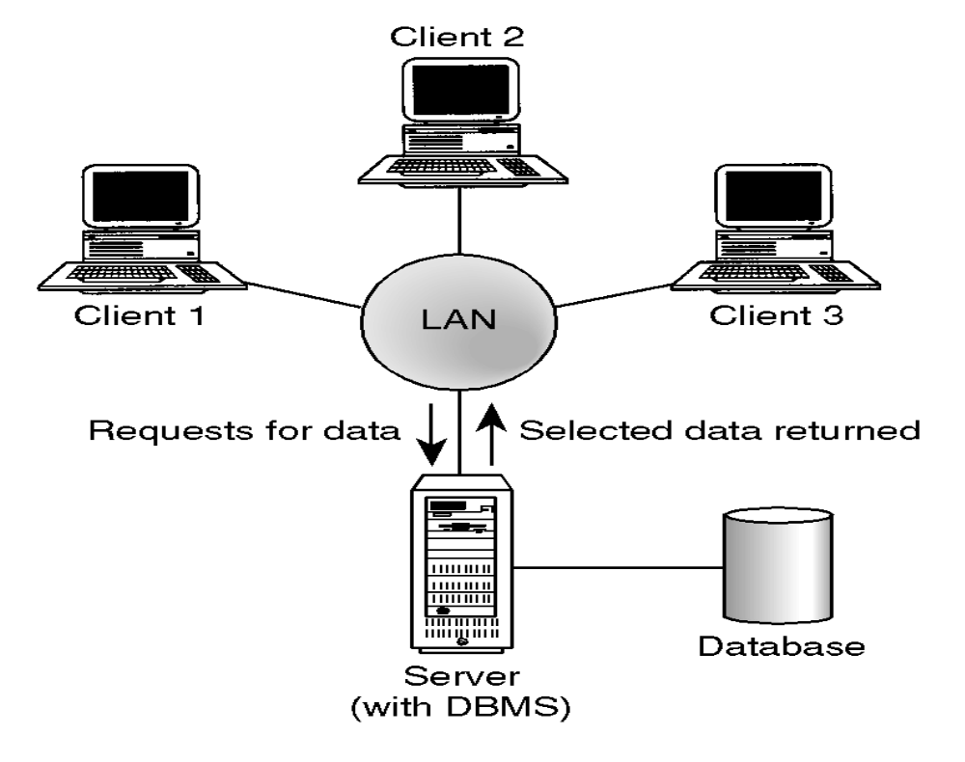
Client-Server Architecture
Introduction to Database Languages
1.<number>

Slide 44
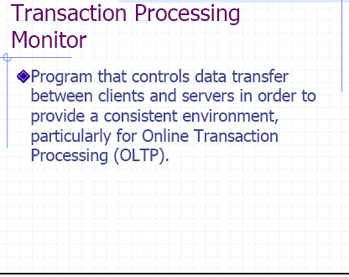
Introduction to Database Languages
1.<number>

Slide 45
TPM
A TPM is a middleware component that provides access to the services of a number of resource managers and provides a uniform interface for programmers who are developing transactional software .
Introduction to Database Languages
1.<number>

Slide 46
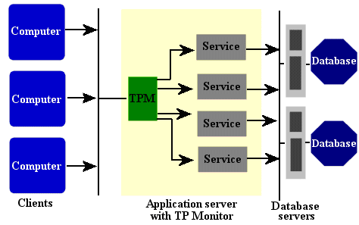
Transaction Processing Monitors
Introduction to Database Languages
1.<number>

Slide 47
When not to use Databases
There are circumstances when databases are not appropriate to be used. These include
a)If the data involved is small and can easily be organized using traditional means.
b) If the application lifespan is small.
Introduction to Database Languages
1.<number>

